Slide 1
Synchrotron Light Source

Slide 2
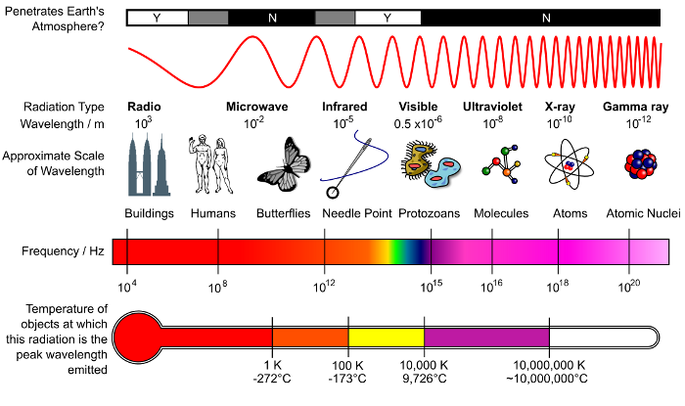
Radiation Spectrum

Slide 3
Wavelength and Photon Energy
The following relations are readily used:
1 angstrom hard x-ray, energy is 12.4keV
Visible light 500nm, energy is 2.4 eV

Slide 4
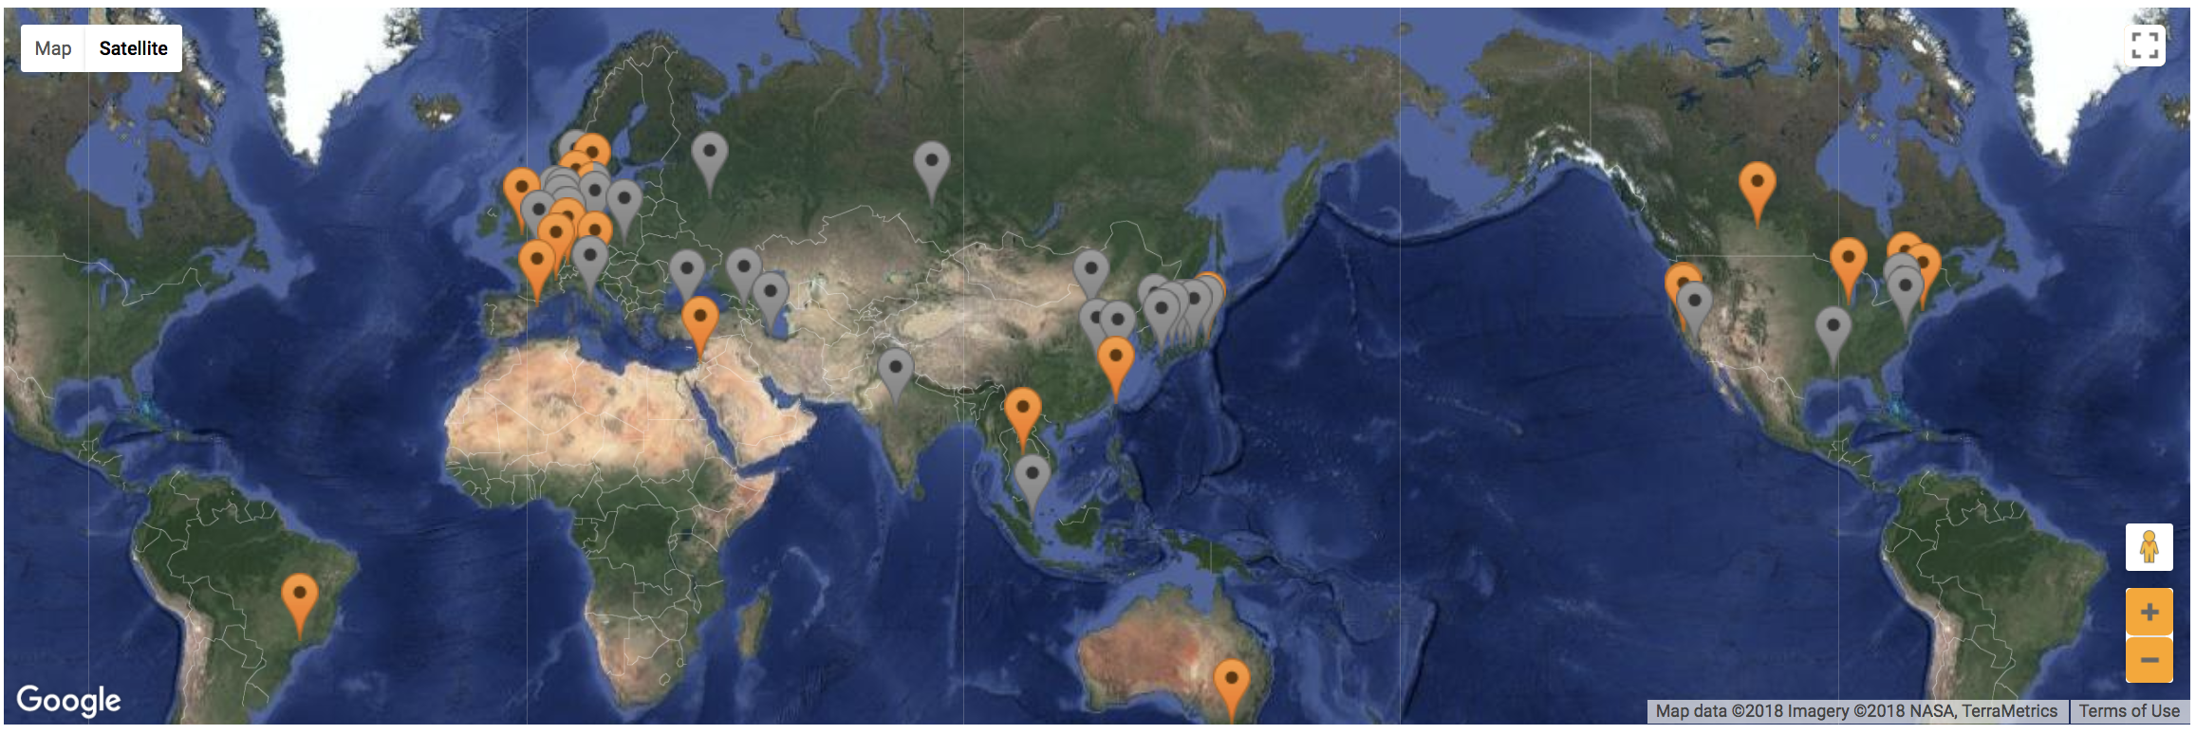
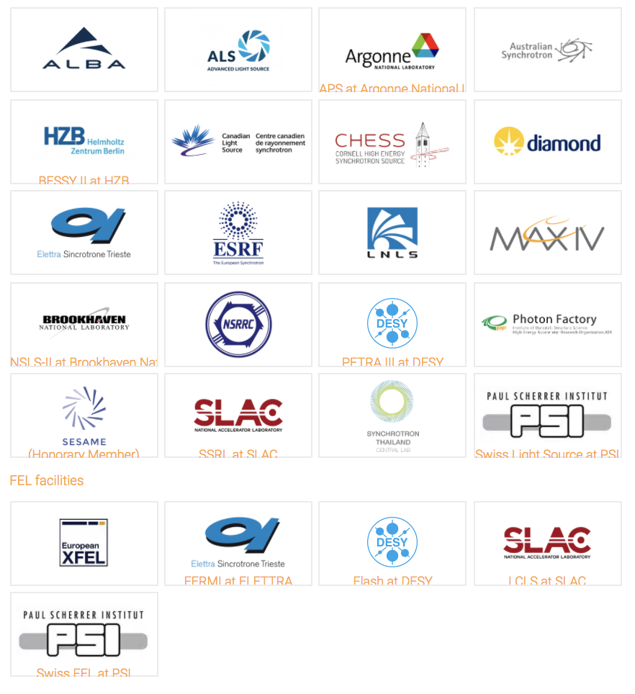
SR Light Source Worldwide
Source: Lightsources.org

Slide 5
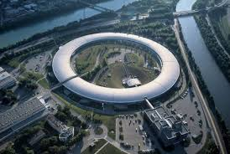
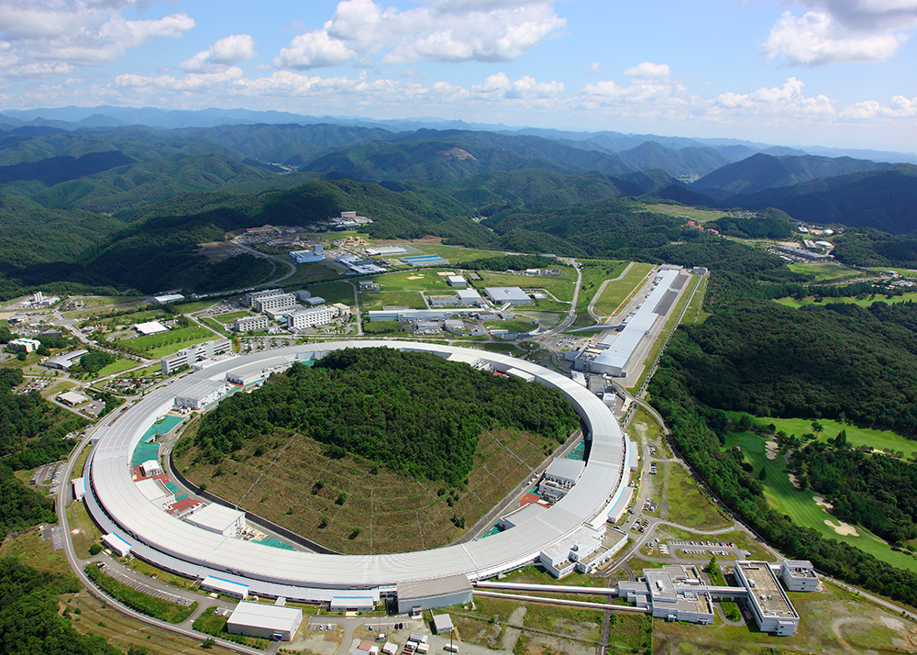
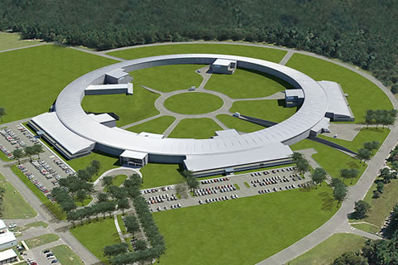
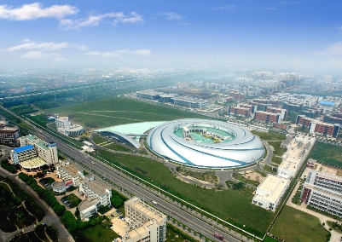
SR Light Source Worldwide
ESRF, 6 GeV
SPring-8, 8 GeV
NSLS II, 3 GeV
SSRF, 3.5 GeV

Slide 6
Example Lattice APS - DBA
Parameters | value
Energy | 7 GeV
C | 1104 m
Ns | 40
eps | 8.22 nm rad
Qx | 35.22
Qy | 14.30
alpha | 2.28e-4
APS @ ANL
APS-U project upgrade the lattice to MBA

Slide 7
Example Lattice NSLS II - DBA
Parameters | value
Energy | 3 GeV
C | 781.0 m
Ns | 15
eps | 2.03 nm rad
Qx | 32.34
Qy | 16.28
alpha | 3.67e-4
NSLS-II @ BNL

Slide 8
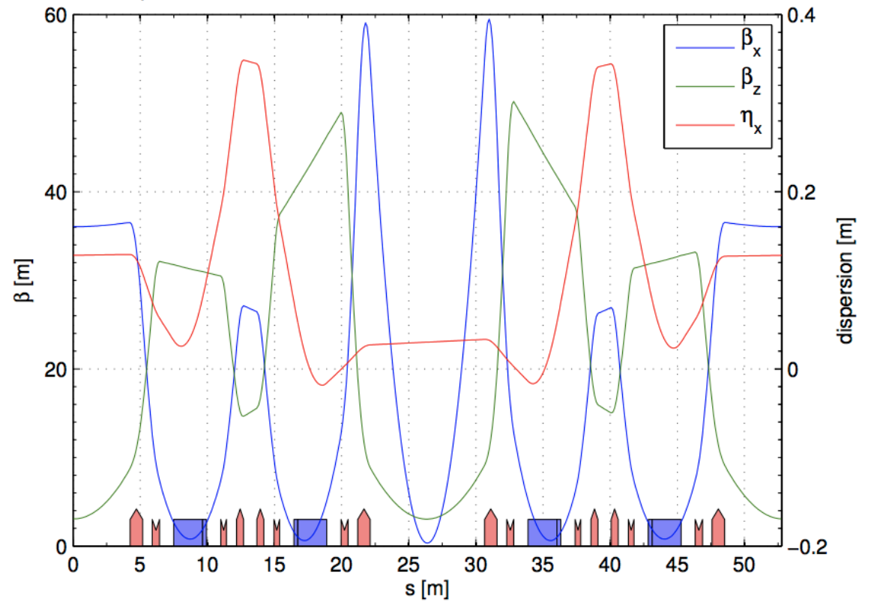
Example Lattice: ESRF - DBA
Parameters | value
Energy | 6 GeV
C | 844 m
Ns | 32
eps | 4.0 nm rad
Qx | 36.44
Qy | 13.39
alpha | 1.78e-4
ESRF @ France
Old DBA lattice

Slide 9
Example Lattice: ALS - TBA
Parameters | value
Energy | 6 GeV
C | 844 m
Ns | 32
eps | 0.134 nm rad
Qx | 76.21
Qy | 27.34
alpha | 8.4e-5
ALS @ LBNL
ALS-U project upgrade the lattice to MBA

Slide 10
Example Lattice: MAX-IV - 7BA
Parameters | value
Energy | 3 GeV
C | 528 m
Ns | 20
eps | 0.33 nm rad
Qx | 42.24
Qy | 16.28
alpha | 3.07e-4
MAX-IV @ Sweden

Slide 11
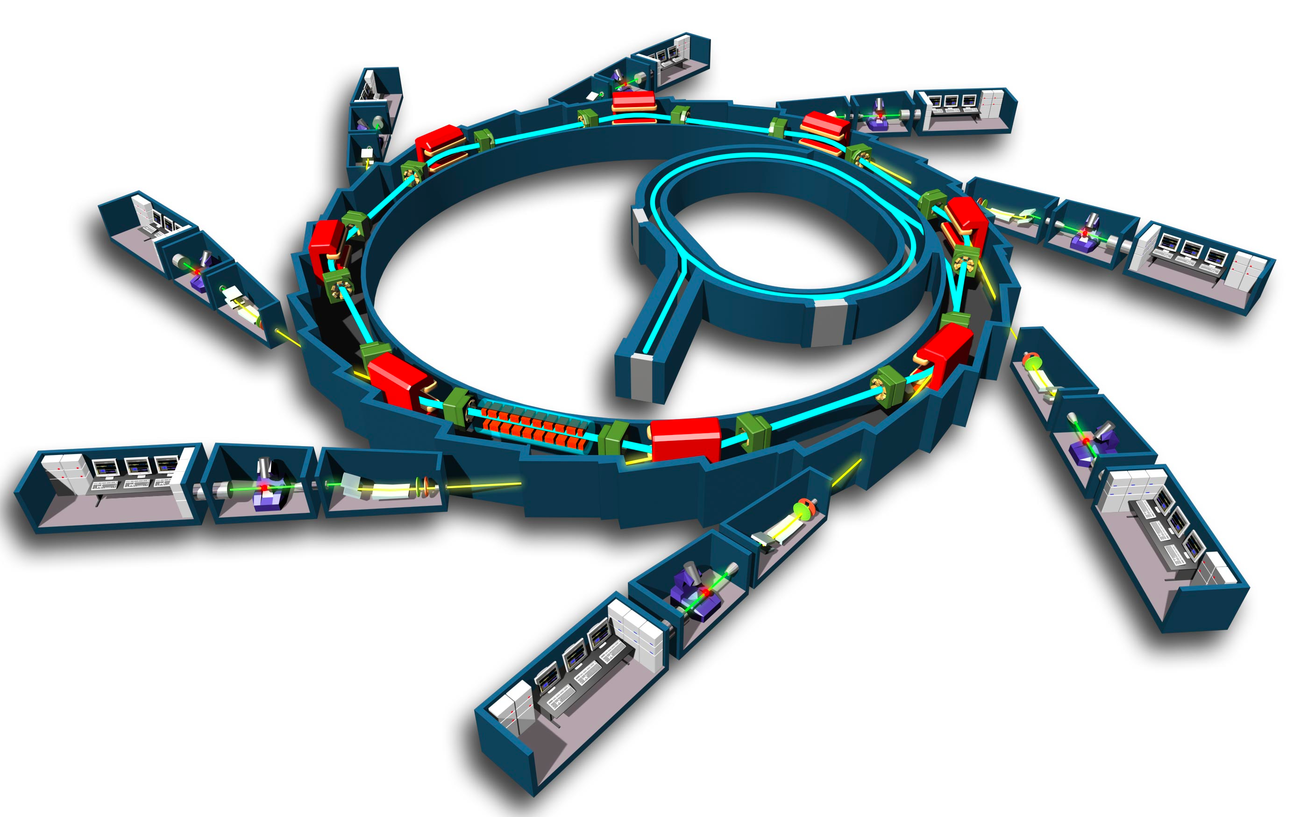
SR Light Source
To produce UV, (soft/hard) X-ray source
Dipole, undulator/wiggler
EXCITING SCIENTIFIC TOOL.
LET LIGHT MEET MATTERS

Slide 12
Performance of light source
Brightness of photon
Flux
Notes:
B=\frac{d^4N}{dtd\Omega dS(d\lambda/\lambda)}

Slide 13
Higher Brightness Enable Us…
Process with less cross section
Trim the light for better
Coherence, monochromatic radiation
Protein Crystallography
Spectroscopy with high resolution
Crystal Diffraction
Many More…

Slide 14
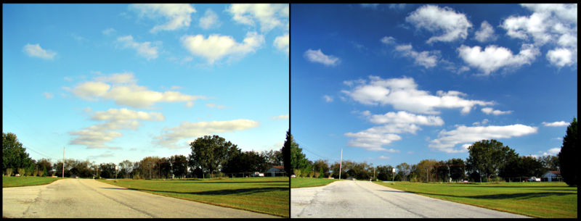
SR is polarized light

Slide 15
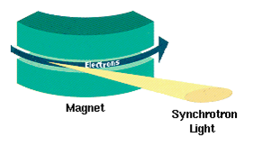
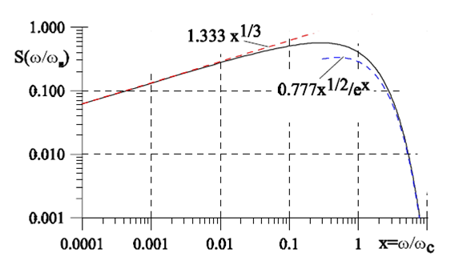
SR from Bending Magnet
Goods
Simple, inexpensive
Broad spectral range
Many beamlines
Bads
Limited hard x-ray components
Not very bright

Slide 16
SR spectrum of Dipole, Energy Dependence

Slide 17
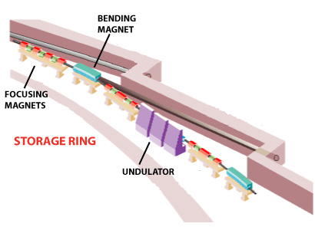
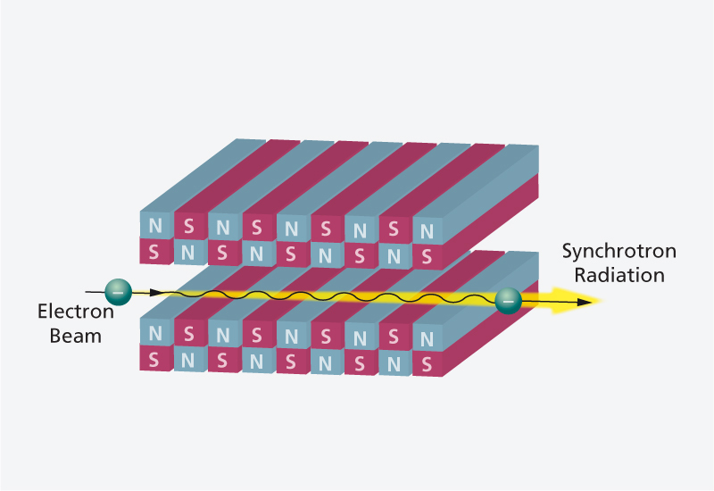
Undulator/Wiggler
In addition to the SR from dipoles, modern light sources has many long straight section with zero dispersion function.
They are undulators and wigglers with similar shape but different parameter.
Example: NSLS II
# of DBA cells: 30
# of 5m straights: 15
# of 8m straights: 15

Slide 18
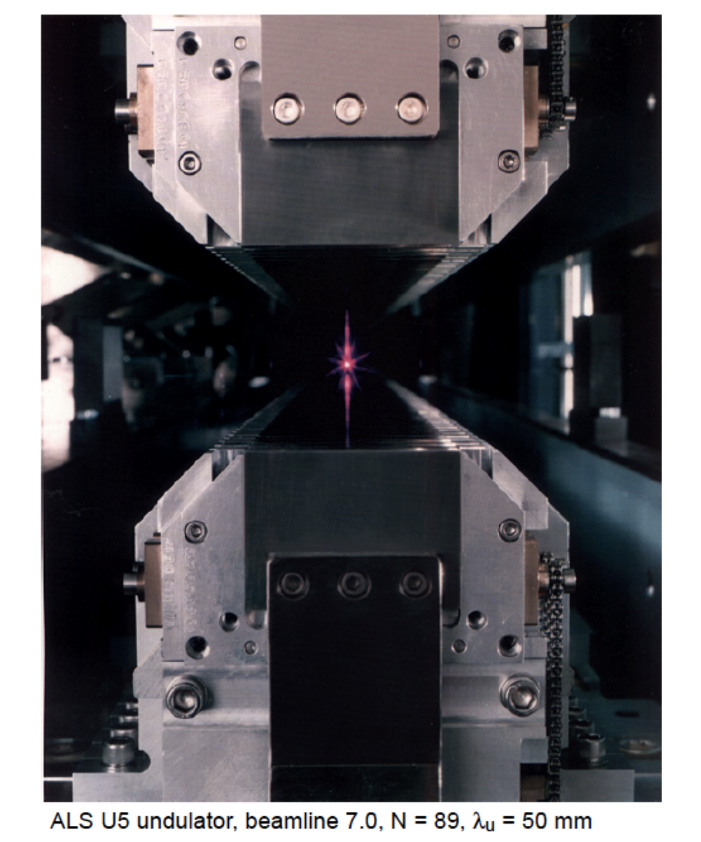
Real Example

Slide 19
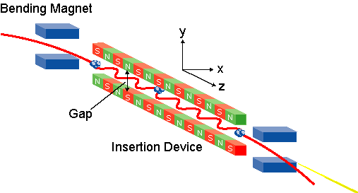
SR from Undulator/Wiggler
They are ‘insertion devices’ in straight sections. Modern accelerators provides many long straight sections.

Slide 20
Difference between bending magnet and Undulator/Wiggler
Courtesy of W. Barletta

Slide 21
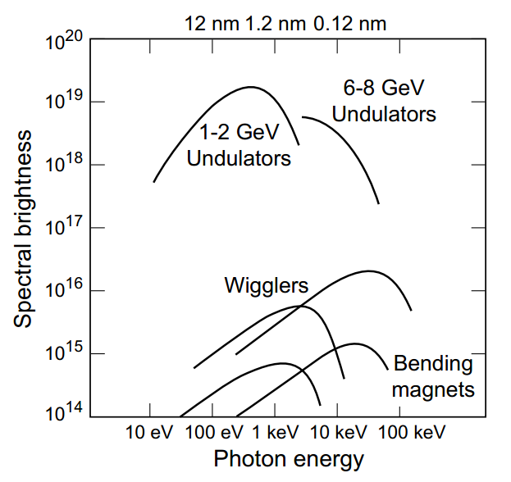
Brightness Comparison
Courtesy of W. Barletta

Slide 22
Electron Motion inside Undulator
Notes:
B=B_y=B_0\cos\frac{2\pi z}{\lambda_u}
\frac{dP_x}{dt}=ecB_0\cos\frac{2\pi z}{\lambda_u}
v_x=\frac{eB_0\lambda_u}{2\pi m\gamma}\sin\frac{2\pi z}{\lambda_u}\equiv\frac{Kc}{\gamma}\sin\frac{2\pi z}{\lambda_u}
K=\frac{eB_0\lambda_u}{2\pi mc}=0.934B_0[T]\lambda_u[cm]

Slide 23
Undulator ‘Slows down’ the electron
oscillating part is averaging to zero
As if the energy of beam changes:
Notes:
v_z=\sqrt{v^2-v_x^2}=c\sqrt{1-\frac{1}{\gamma^2}-\frac{K^2}{\gamma^2}\sin^2\frac{2\pi z}{\lambda_u}}
=c(1-\frac{1+K^2/2}{2\gamma^2}+\frac{K^2}{4\gamma^2}\cos\frac{4\pi z}{\lambda_u})

Slide 24
In electron ‘s rest frame
The electron sees contracted undulator
The frequency of the radiation is
In lab frame, the frequency of the radiation is different(relativistic Doppler Effect)
Notes:
f=\frac{f^\prime}{\gamma^*(1-\bar{\beta_z}\cos{\theta})}=\frac{c}{\lambda_u(1-\bar{\beta_z}\cos{\theta})}

Slide 25
Resonance Condition
The wavelength of the radiation in the lab frame:
Recall that:
And we only care of small forwarding angle:
Finally the wavelength reads:

Slide 26
Radiation for K<1
Radiation Bandwidth:
Angle for central cone
Courtesy of W. Barletta
Power:

Slide 27
Wiggler Radiation
When K>>1, the high harmonics become important and very dense.
The envelope is similar to the SR from dipoles. The brightness is increased by 2N

Slide 28
Beamline 101

